Slide 1


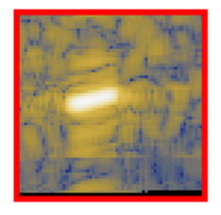
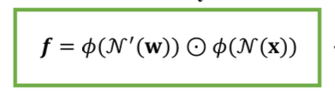
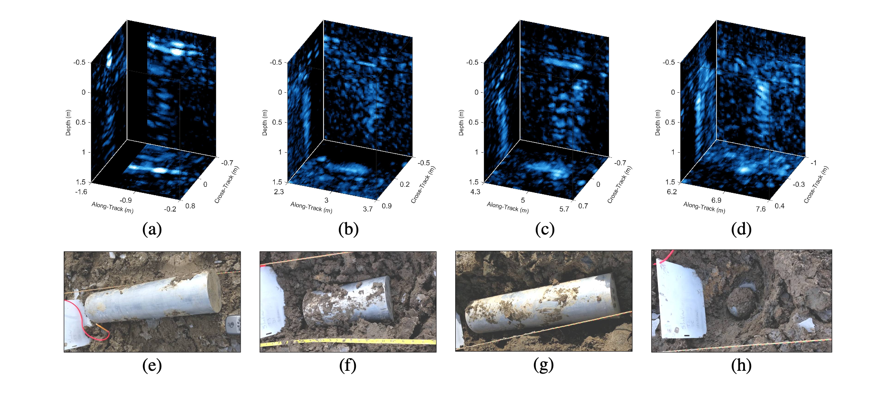
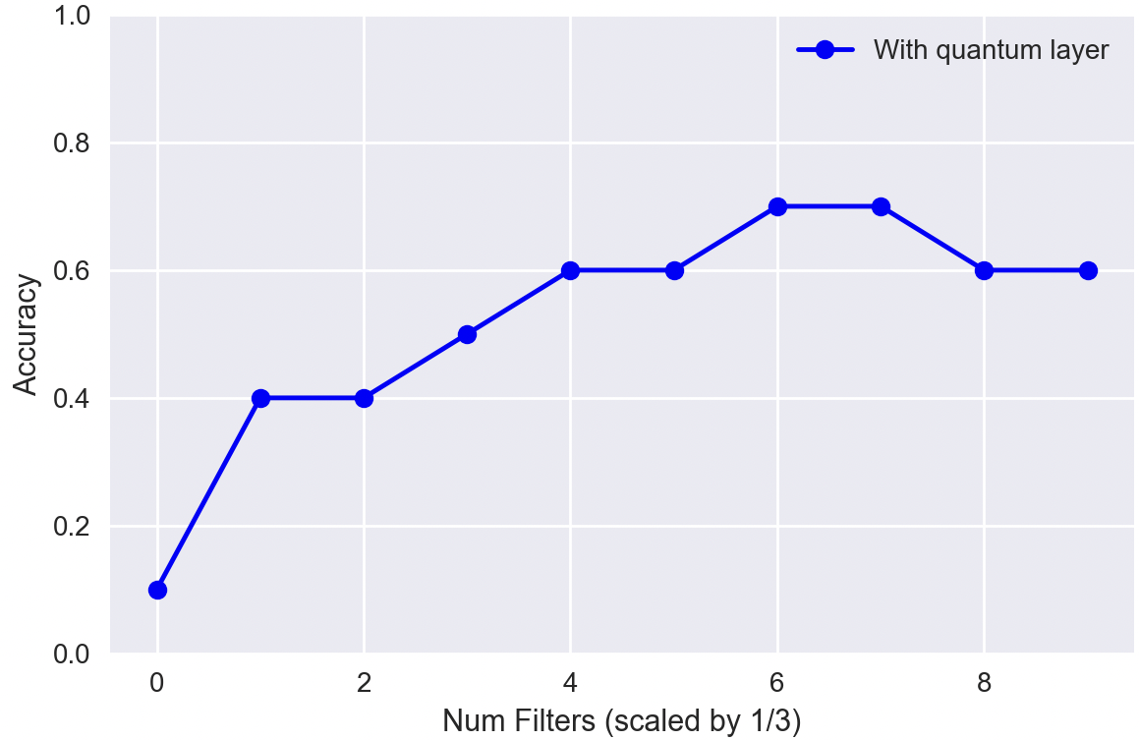
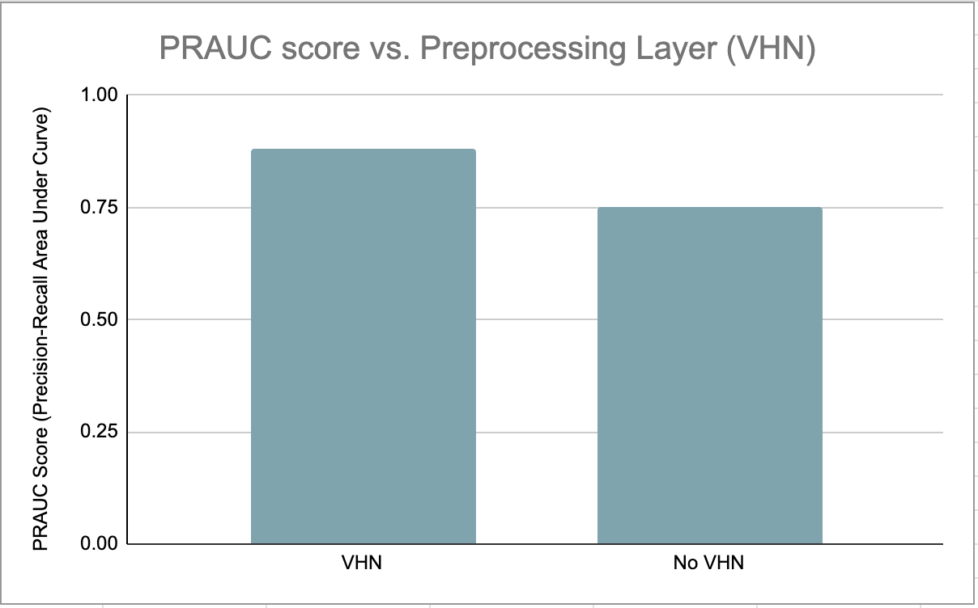
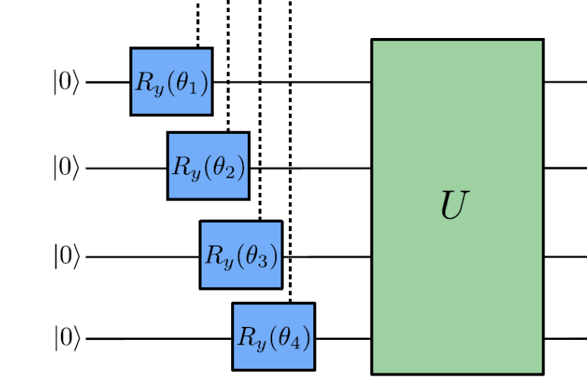
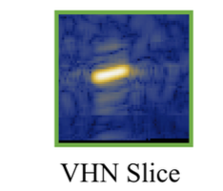
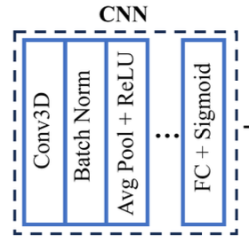
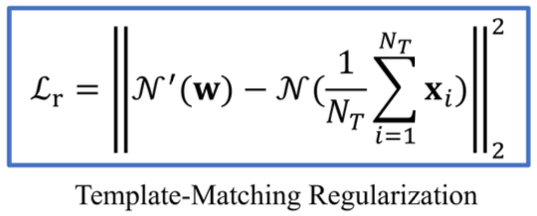
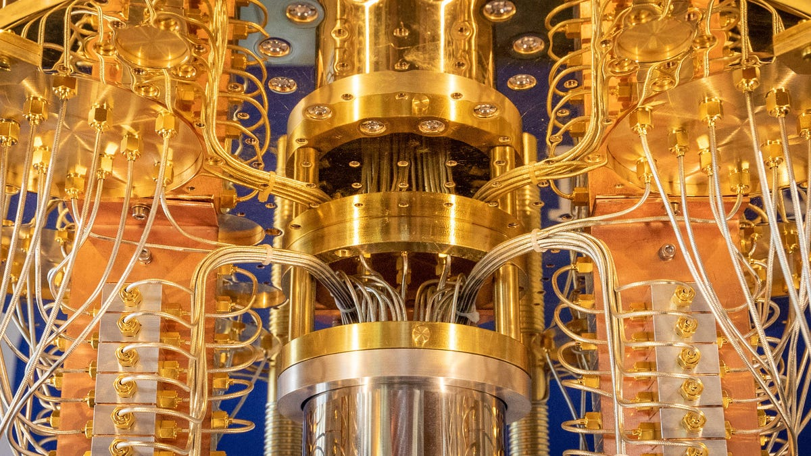


Preprocessing Optimization for SAS/R* Classification and Detection
2024 Quantum Machine Learning REU Program
Chris Su^{[1][4]}, Greg Vetaw^{[1][3]}, Glen Uehara^{[2][3]}, Dr. Suren Jayasuriya^{[1][3]}, Dr. Andreas Spanias^{[2][3]}
[1]Imaging Lyceum Lab, [2] SenSIP Center, [3] Arizona State University, [4] Carnegie Mellon University
Research Background/Description
PROPOSED ARCHITECTURE
Experimental Results
Preprocessing data is crucial for the performance of many statistical techniques including machine learning algorithms.
With improvements in quantum fidelity in recent years, we investigate a hybrid preprocessing architecture for increased efficiency and accuracy* in SAS/R* classification and detection tasks.
A 3D SAS cube is fed into a quantum convolutional circuit with k*k*k kernel size to produce f filtered data cubes. Together, with the Volumetric Hadamard Normalized, (eq pictured in Fig 3) the CNN classifies targets and non targets.
Fig 4 shows preliminary testing with a small subset of the MNIST dataset for a purely quantum preprocessing layer. The accuracy is graphed as a function of number of filters 3f.
Fig 5 is the baseline results for a purely classical algorithm with and without the VHN preprocessing layer on a small subset of the SVSS dataset (3D SAS Cubes).
Input Cube (2D Slice)
Research Objectives/Plan
…………………………….
Fig 3
Fig 1 3D SAS cubes and respective targets
……………….
Fig 4
Fig 5
Machine Learning is one of the most effective tools in classifying and detecting targets from non-targets, when data often contains many clutter objects or when data is produced by weak acoustic signals. [2]
We investigate applications of a VHN preprocessing layer [1] with quantum convolutional kernels in CNN-based architectures.
……….……….……….……………………………...
CHALLENGES / Conclusions
….
..…….
Current quantum simulations take a tedious amount of time to run.
Our models that implement hybrid architecture have been limited to testing on smaller datasets, but future works will begin testing / simulating with larger datasets soon
Future research will look into preprocessing layers for 2D SAR detection
…………………….
.….
References
[1] G. Vetaw, “Volumetric Hadamard Normalization for Sub-Bottom SAS ATR”
[2] D. Williams and D. Brown, “New target detection algorithms for volumetric synthetic aperture sonar data,” Proc. of Meetings on Acoustics, vol. 40, p. 070002, Sept. 2020.
[3] Henderson, Maxwell P. et al. “Quanvolutional Neural networks: powering image recognition with quantum circuits.” Quantum Machine Intelligence 2, 2019
[4] Uehara, G. S., Spanias, A., & Clark, W.. Quantum information processing algorithms with emphasis on machine learning. In IEEE IISA, July 2021.
[5] Miller, L., Uehara, G., & Spanias, A. (2024, March). Quantum Image Fusion Methods for Remote Sensing. In 2024 IEEE Aerospace Conference (pp. 1-9). IEEE.
Fig 2 Regularization for VHN layer
*SAS/R: Synethetic Aperture Sonar / Radar; accuracy* refers to a general metric on model performance, i.e: for classification tasks, we refer to PRAUC score
Sensor Signal and Information Processing Center
https://sensip.asu.edu
This work is funded in part by NSF Award 2349567

